Slide 1
Growing litigation risks in Europe – the significance for US businesses
Kaarli Eichhorn
Partner, Jones Day
Simon Neill
Senior Legal Director, Johnson & Johnson
Kim Watts
Senior Policy Manager, AmCham EU

Slide 2
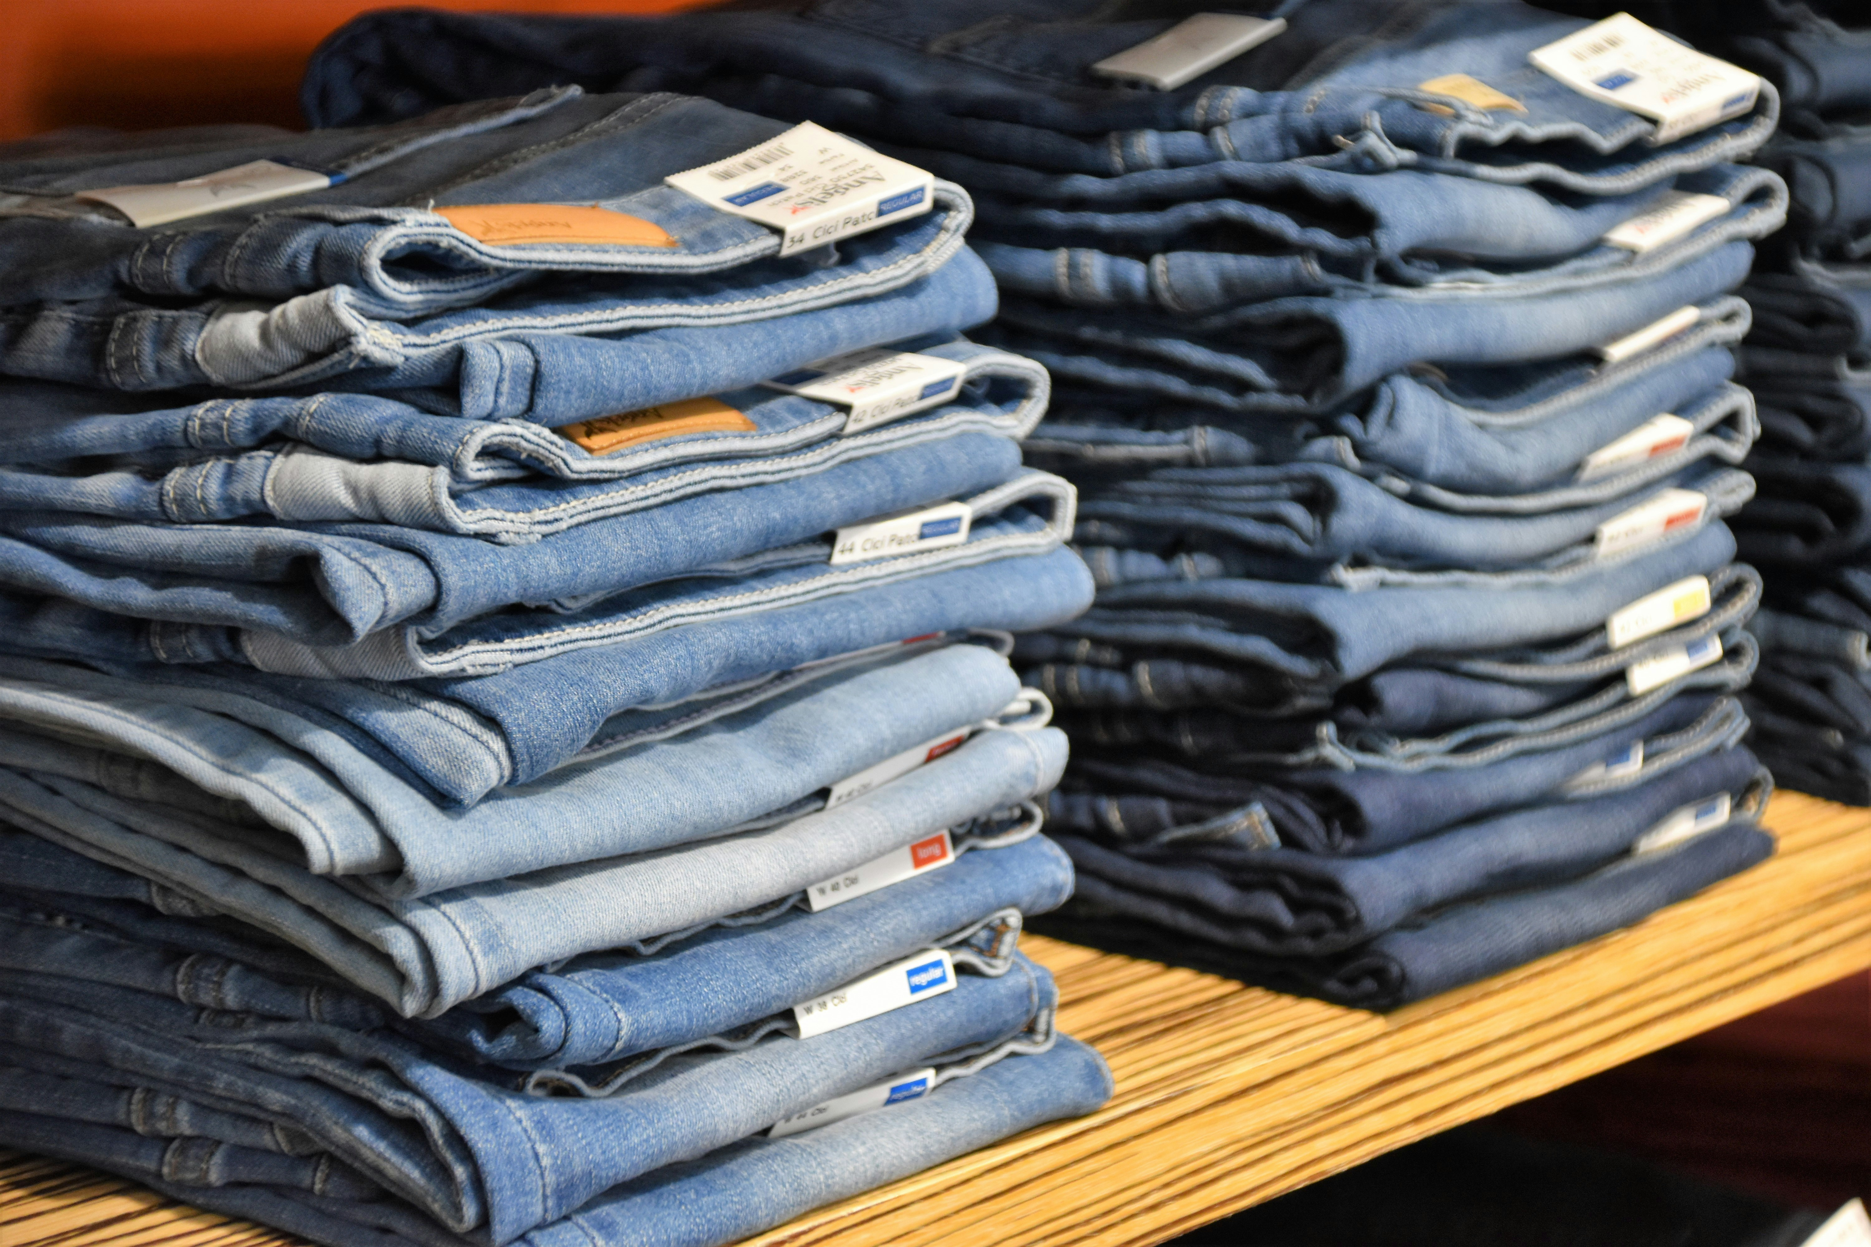
Many good things come from America
Image credit: Waldemar, Praveen Thirumurugan and Ashes Sitoula on Unsplash

Slide 3
Many good things … ?
The U.S. mass claim & class action system
Legal defence costs are significant
Over half of U.S. Fortune 1000 companies face class action claims each year
Corporate legal defence costs in the U.S. were estimated to exceed $3.6 billion in 2022 alone
Where will Europe go?
Image credit: Bermix Studio on Unsplash

Slide 4
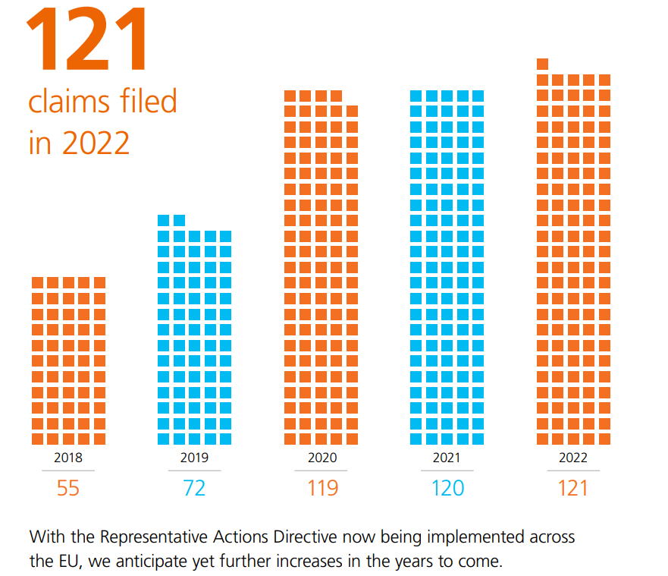
A pandora’s box for our members
Image credit: CMS law, Euronews, Wall Street Journal, Emerging Europe
Notes:
Sources
https://cms.law/en/media/international/files/publications/publications/european-class-action-report-2023?v=1%22%20\t%20%22_blank
https://www.euronews.com/2024/02/19/the-sultanate-of-sulu-case-shows-the-litigation-funding-industry-is-abusing-the-global-leg
https://emerging-europe.com/partner-content/surging-wave-of-class-actions-sweeps-europe/
https://www.wsj.com/articles/companies-on-the-defensive-as-european-union-rolls-out-class-action-lawsuits-4159cb6d

Slide 5
Setting the scene
Class actions a feature of the US litigation landscape for decades
EU legal landscape changing dramatically – class actions rising exponentially
Class actions are becoming a significant corporate risk
The Representative Actions Directive (2020), entered into force in June 2023; other important changes will be brought about by proposals for Product Liability Directive, CS3D, AILD etc
Plaintiff firms and third party litigation funding (“TPLF”) market booming in Europe

Slide 6
Representative Actions Directive
The Representative Actions Directive (“RAD”) requires each EU Member States to have in place a mechanism allowing consumers to bring class actions
Various EU law infringements covered, including in energy, telecommunications, financial services, travel and tourism, data protection and product liability
The establishment of this common legal framework is expected to drive a significant increase in the number of class actions launched in the EU
Image credit: Jake Weirick on Unsplash

Slide 7
Experience shows EU class actions will grow
The experience of the Netherlands provides insight - class action regime largely in line with RAD requirements a very popular forum for this form of litigation in recent years, with well-publicized claims being launched against global companies such as Shell, Google and Meta.
Remains to be seen how RAD will exactly operate in practice in each EU jurisdiction
Image credit: Max LaRochelle on Unsplash

Slide 8
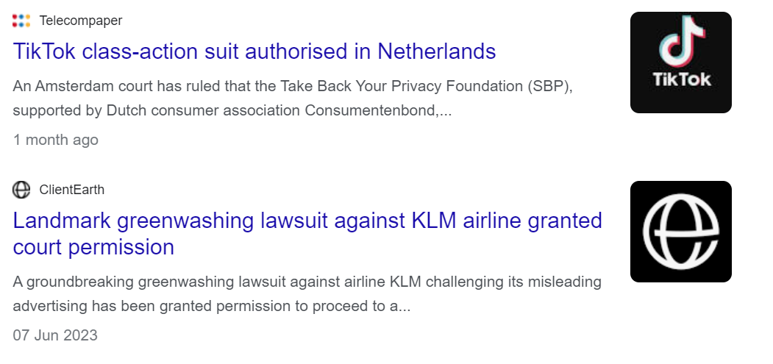
Experience shows EU class actions will grow

Slide 9
U.S. mass claims system – business model
Well developed plaintiff bar
TPLF
Aggressive marketing
TPLF firms and law firms are working together to pursue novel claims
Pressure on defendants to settle
Image credit: engin akyurt on Unsplash

Slide 10
What is driving the growth in mass claims?
Claimant-focused law firms
Growth in litigation funding
Evolving legal frameworks
Tailor-made class action mechanisms are being introduced across Europe. But we are also seeing increased judicial openness to existing procedures being expanded and used to bring group actions.

Slide 11
“The result is an opaque, bottom-up wealth transfer from consumers to sophisticated investors and law firms.”
Swiss Re 2021 Report
“US Litigation Funding and Social Inflation”

Slide 12
Who is at risk and what we can we do?

Slide 13
Our members are all at risk
Most class action claims & growth in Netherlands, Poland, Slovenia, and Portugal – but risk is present in every EU member state
Topics – shareholder actions product liability, competition
Our companies will have to spend significant time and resources in advance on risk mitigation strategies and preparing for complex litigation, in each EU member state
We can help each other to raise awareness & engage with decisionmakers

Slide 14
Civil Justice Certainty = Competitiveness
Image credit: World Justice Project Rule of Law Index & EU Competitiveness Index
Notes:
Chart on left – World Justice Project Rule of Law Index
Map on Right – EU Competitiveness Index

Slide 15
What can we do together?
Raise awareness at EU and Member State level of the risk of TPLF and the growth of class actions
Explain to decisionmakers that more litigation does not = more justice for consumers – cost, delays and clogging up domestic courts
Engage with decisionmakers on regulating TPLF and reinforce homegrown legal traditions / legal ethical rules
If we do not engage decisionmakers, those who stand to profit will do it
Our member companies uniquely understand the danger of US-style litigation culture spreading in Europe

Slide 16
This is your content
Thank you!
Any questions?

